Slide 1
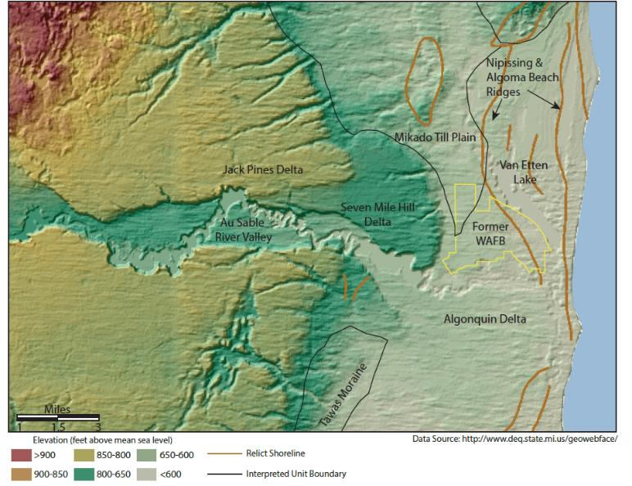
Overview of Conceptual Site Model (CSM)
Geology of the site:
    The plumbing that controls groundwater flow paths
Hydrogeology of the site:
    Where the water and PFAS is moving to and from
  Analytical Trends
Today’s Presentation
    Evolution of CSM
    Van Etten Lake/creek
    Clark’s Marsh
    Q&A
1
Notes:
The goal is to present the general contents of the CSM provided In the QAPP, with some additional explanation and
Then move on to present and facilitate discussion of groundwater dynamics at base boundaries with emphasis on Van Etten Creek, Van Etten Lake, and The Au Sable river valley

Slide 2
Aquifer: High permeability geologic unit
Aquitard: Low permeability geologic unit
Potentiometric Surface: Water table (shallow aquifer), or surface connecting hydraulic head elevations of a deeper aquifer or aquitard
Environmental Sequence Stratigraphy: A method of interpreting stratigraphy using grainsize trends, geologic background, and depositional analogues
Hydrostratigraphy- An assessment of site stratigraphy in context of capacity to move water

Slide 3
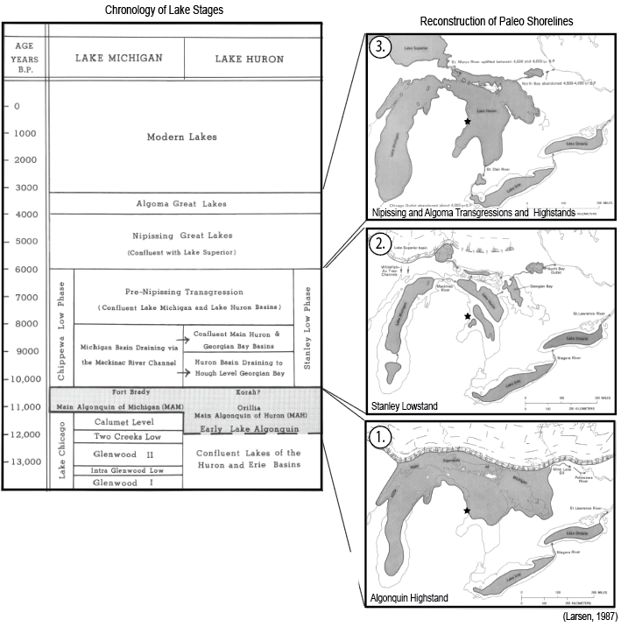
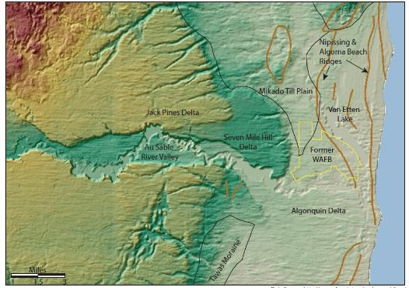
Geologic Evolution of Site Stratigraphy
Regional Geologic Events
4.
Topographic Landforms
3a.
3b.
A.&B.
4.
2.
A.&B.
3.
1.
Notes:
What is Sequence Stratigraphy as well

Slide 4
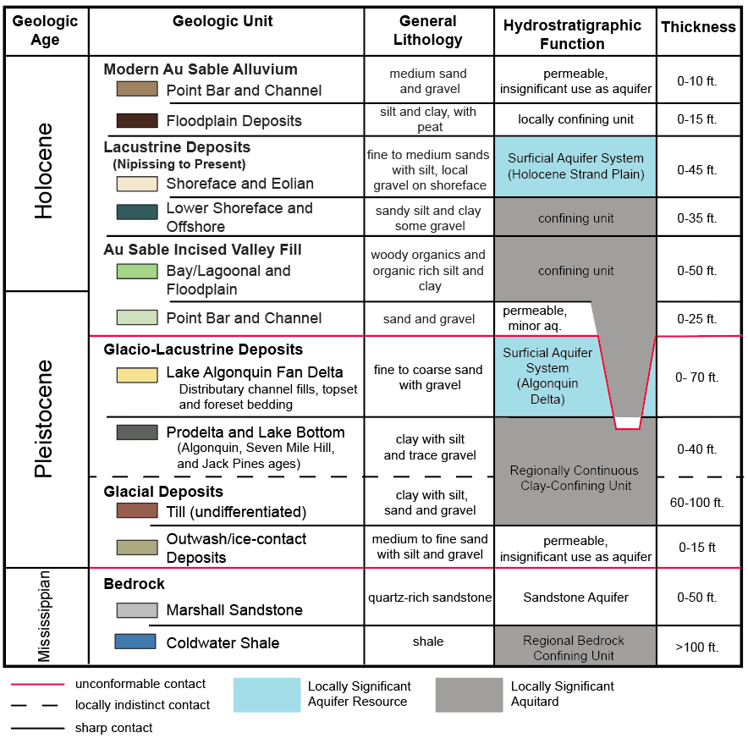
Hydrostratigraphic Column: Water Bearing Zones

Slide 5
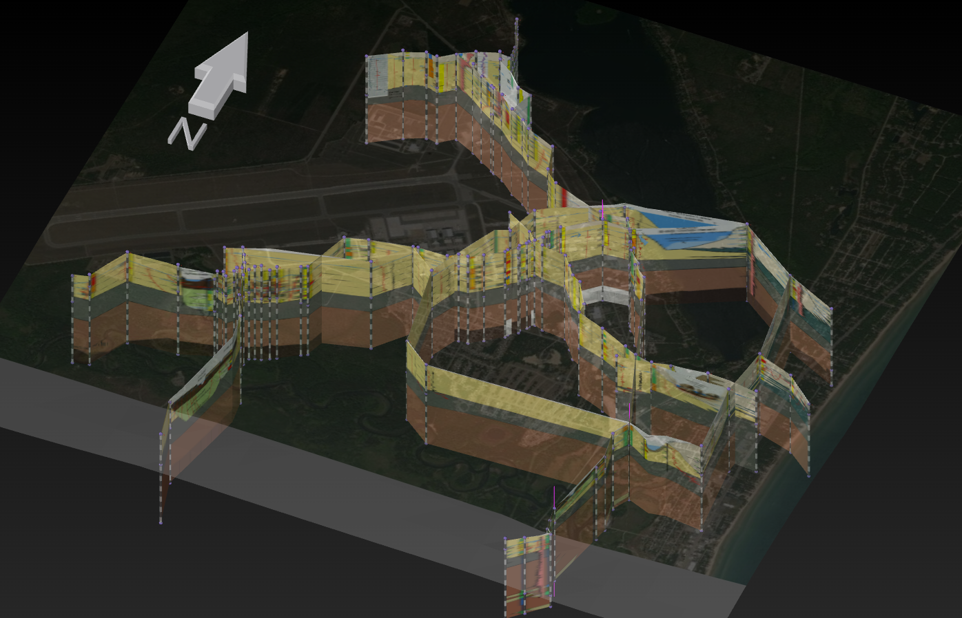
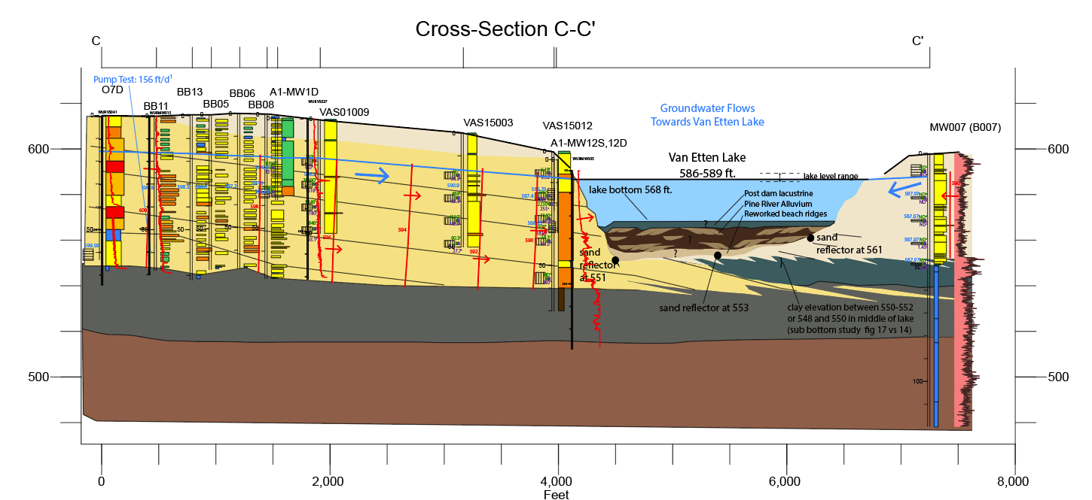
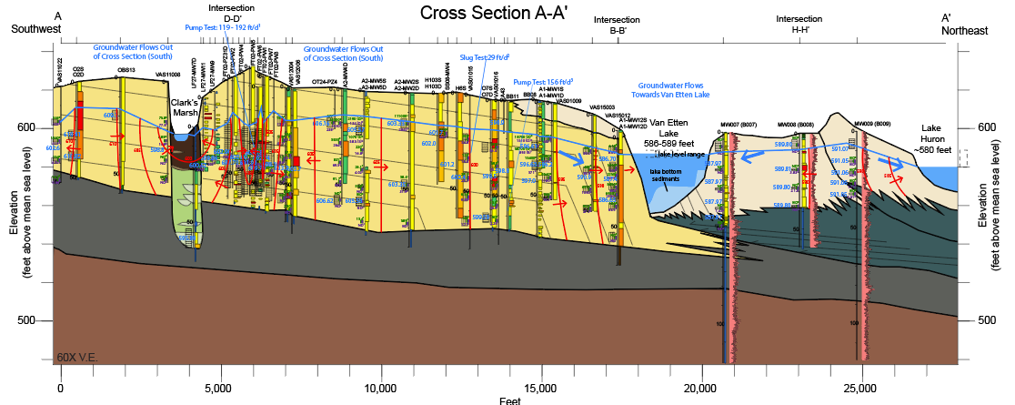
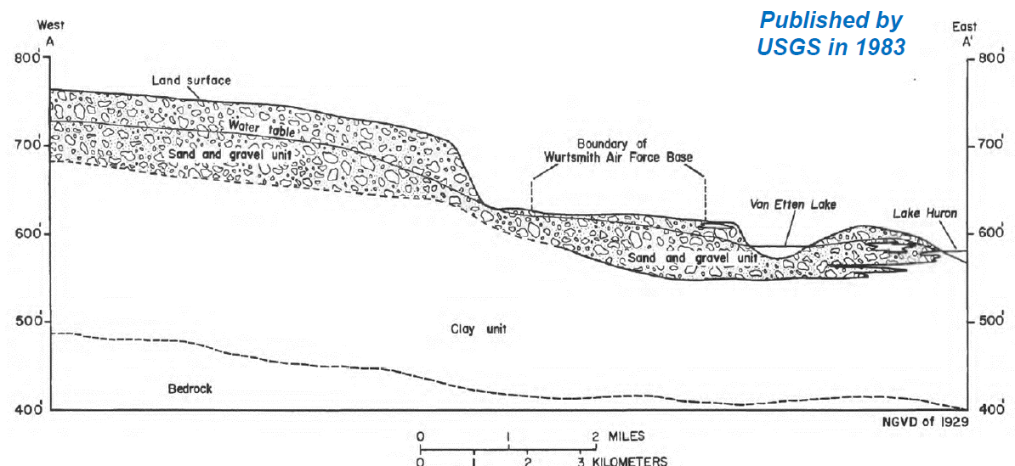
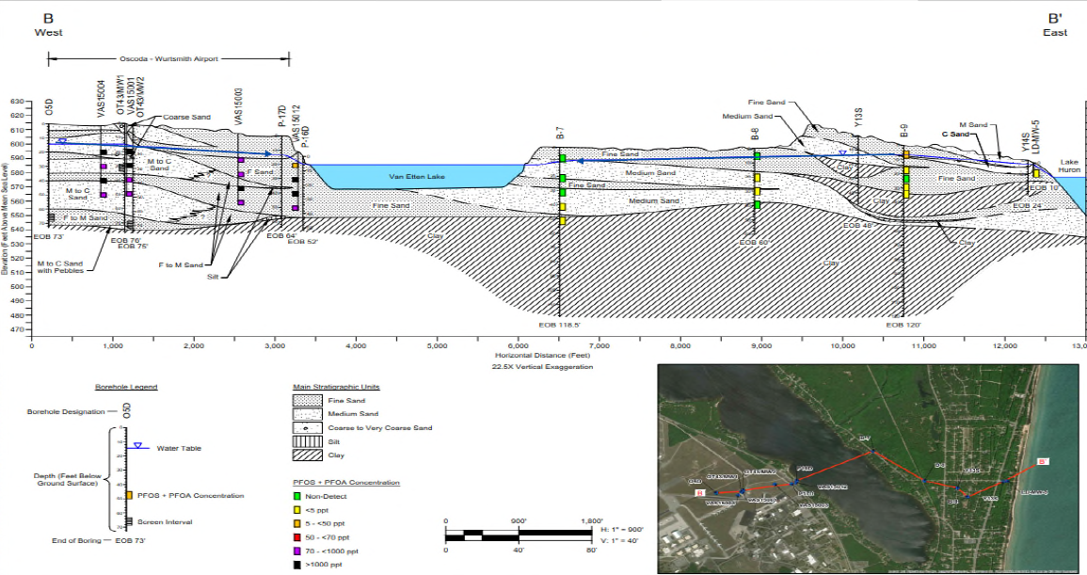
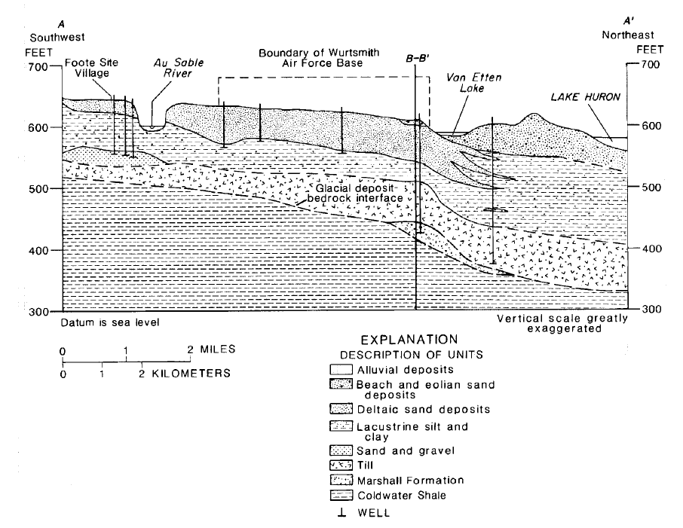
Evolution of CSM and Stratigraphic Interpretations

Slide 6
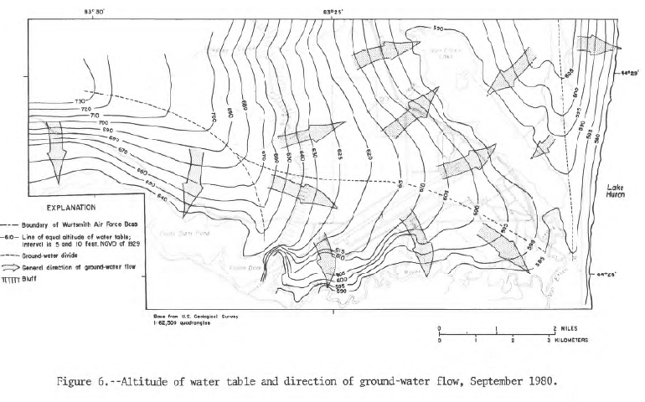
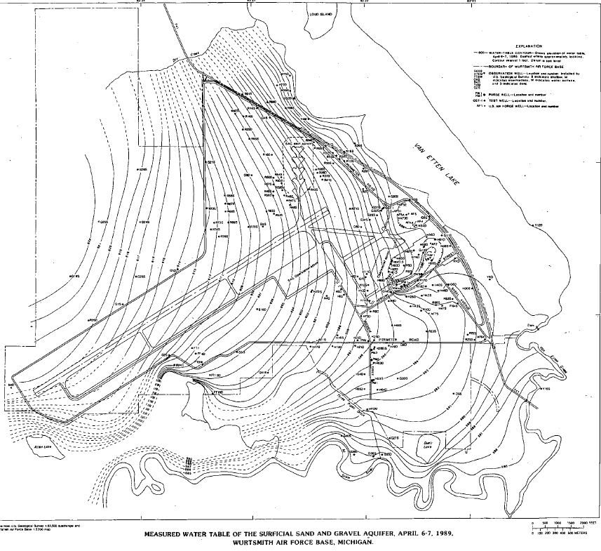
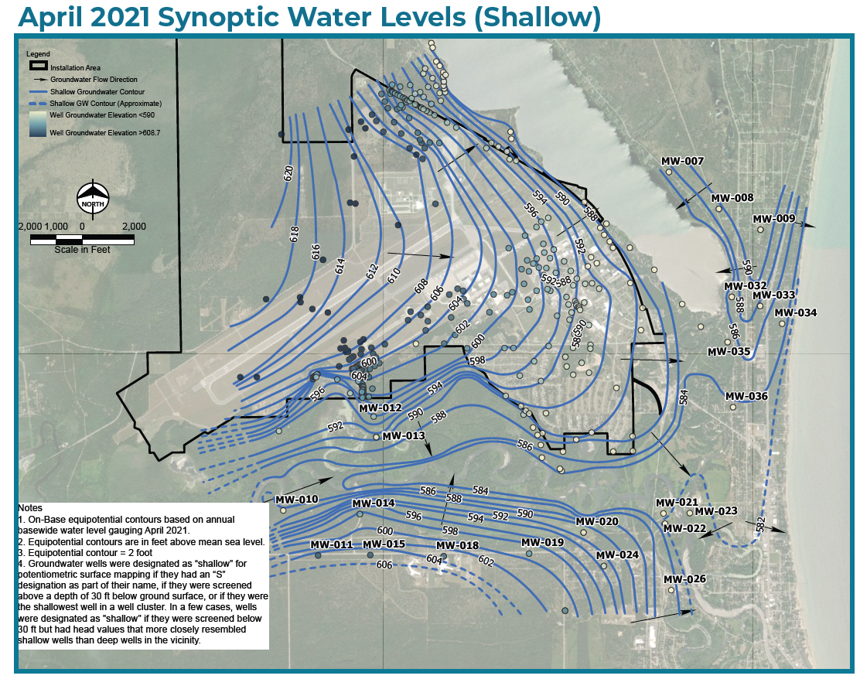
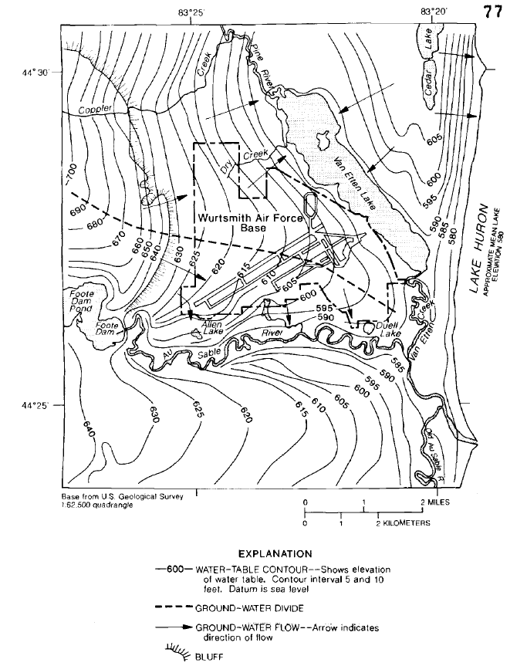
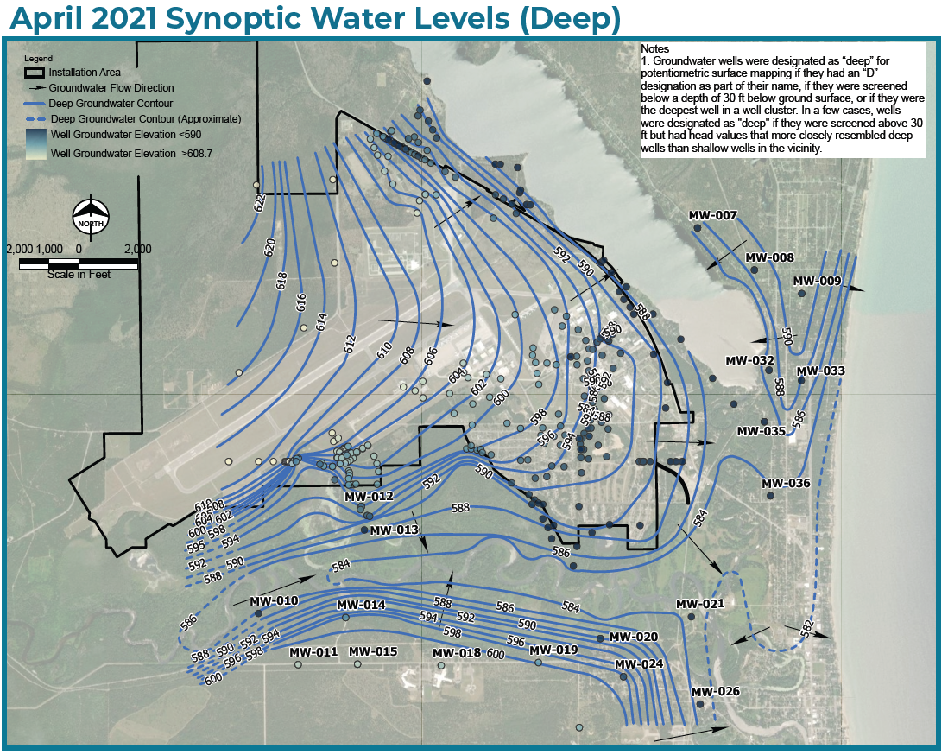
Evolution of CSM and Potentiometric Interpretations

Slide 7
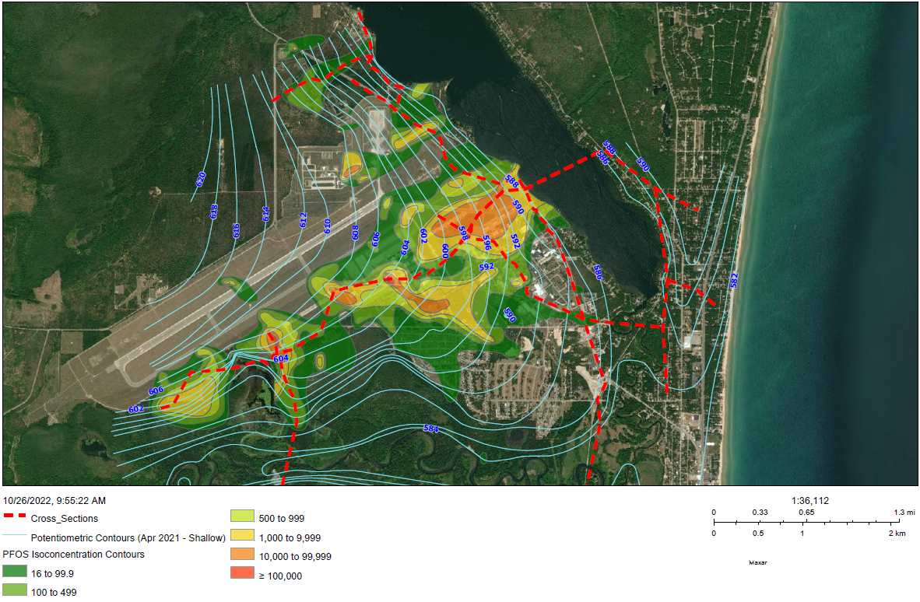
PFOS

Slide 8
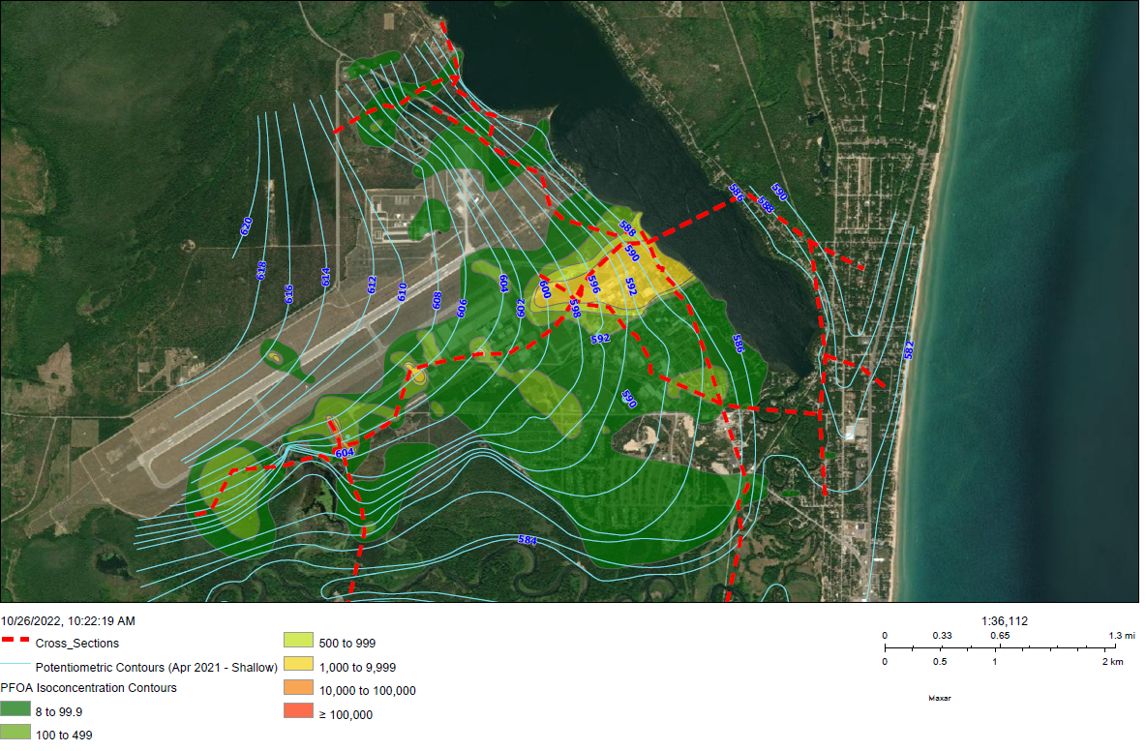
PFOA

Slide 9
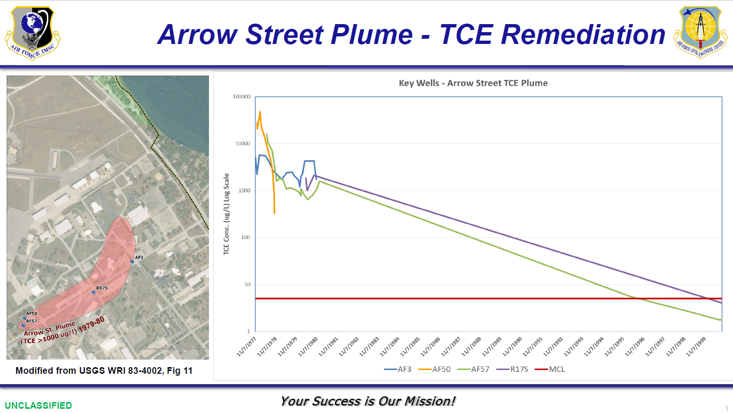

Slide 10
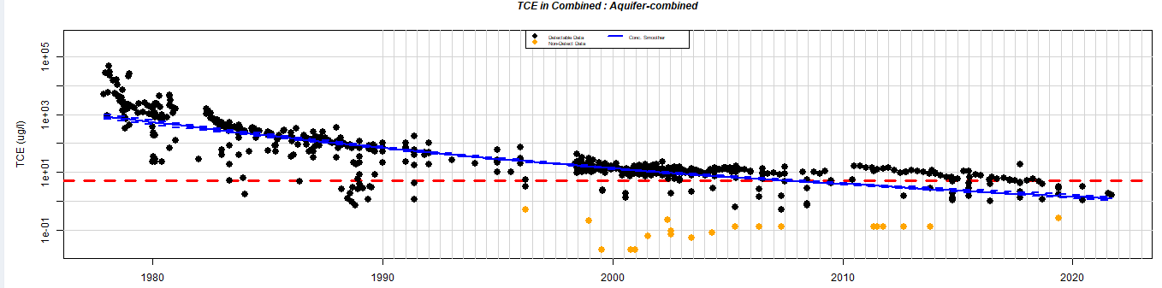
  Arrow Street Plume - TCE Remediation
Combined Key Arrow Street Plume Wells – AF1, AF3, AF50, AF57, PW-1 ARW, PW-2 ARW, PW-3 ARW, PW-4 ARW, R17S, R6S, R7S, and AS-Influent
Log Scale

Slide 11
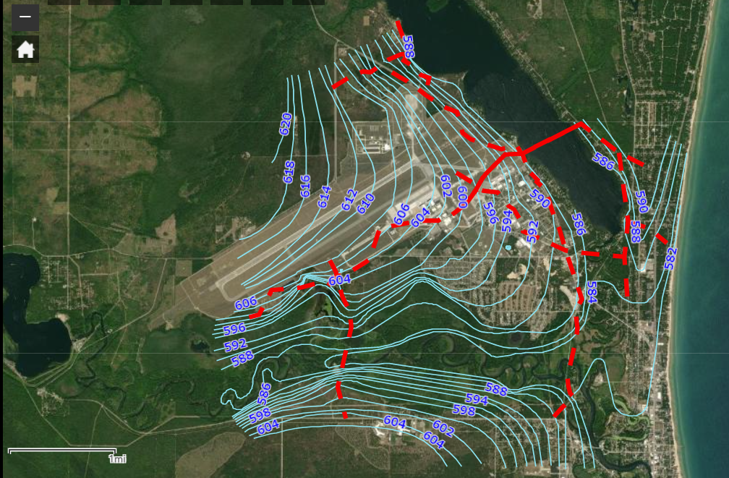
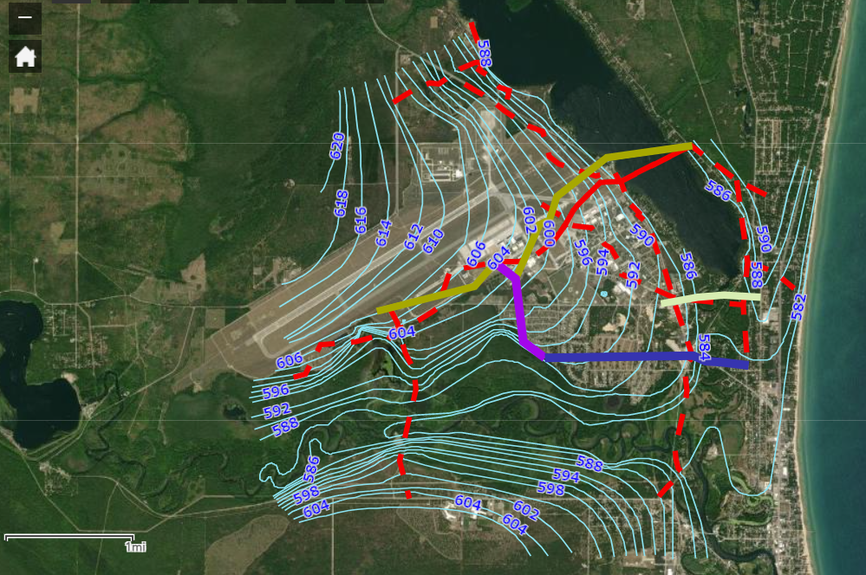
Cross Sections and Ground Water Flow Overview
Notes:
Will use the DSMT to dynamically move around map, zoom in and out. Close up here for backup

Slide 12
Pause- Questions/Discussion

Slide 13
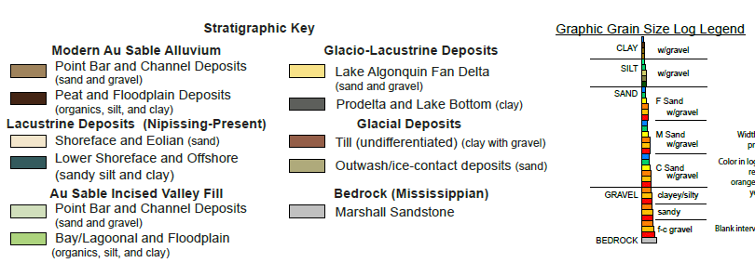
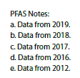

Stratigraphic Cross Section Key
Notes:
Facies pairs, lighter= more permeable, but be careful of bay lagoonal deposits.
Explain Grainsize key,

Slide 14
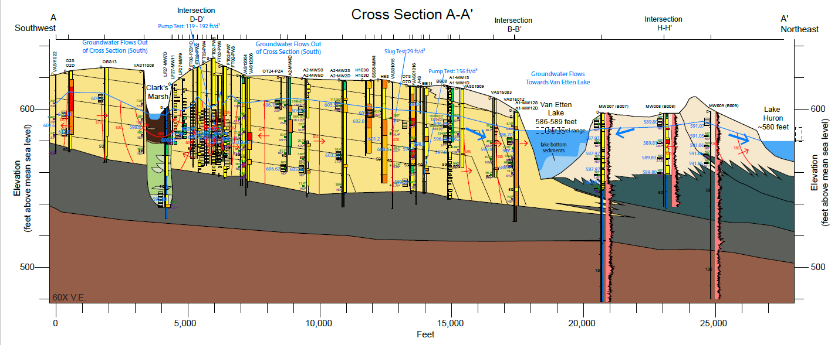
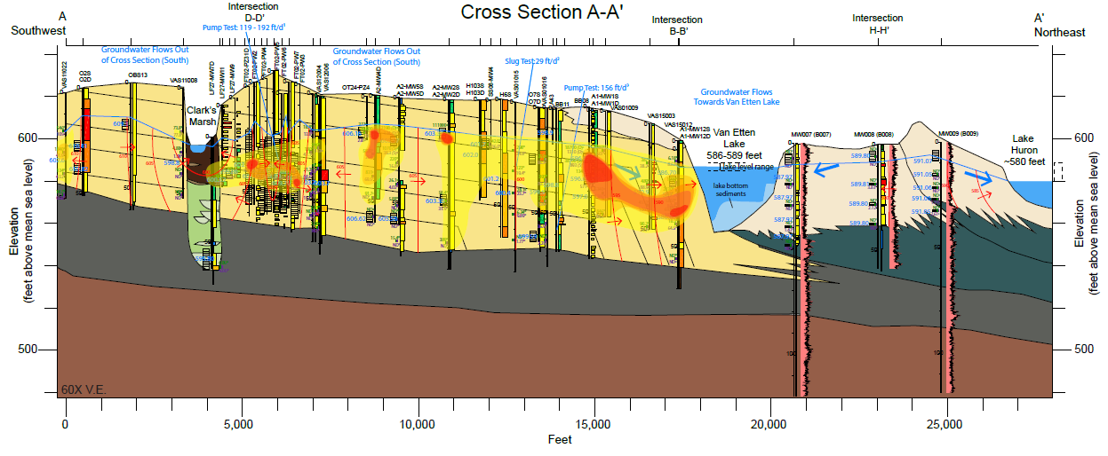
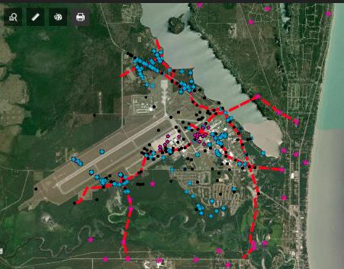
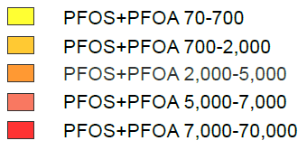
Overview: Cross Sections A, C, D, and E
A’
A
Notes:
Take your Time
PDF to be used for details, cover basics, not nested well details. Talk about equipotentials and what they mean.
Take time here to point out basic aquifer/aquitard elements and then major features:
Limited connectivity beneath Van Etten due to onlapping clays and pinchout/downlap
Robust basal aquitard
Ground water Divide east of Van Etten supported by heads in nested EGLE wells
Fine grainsizes under Clark’s marsh, isolated sands at depth
Converging flow (out of plane) at Clarks marsh

Slide 15
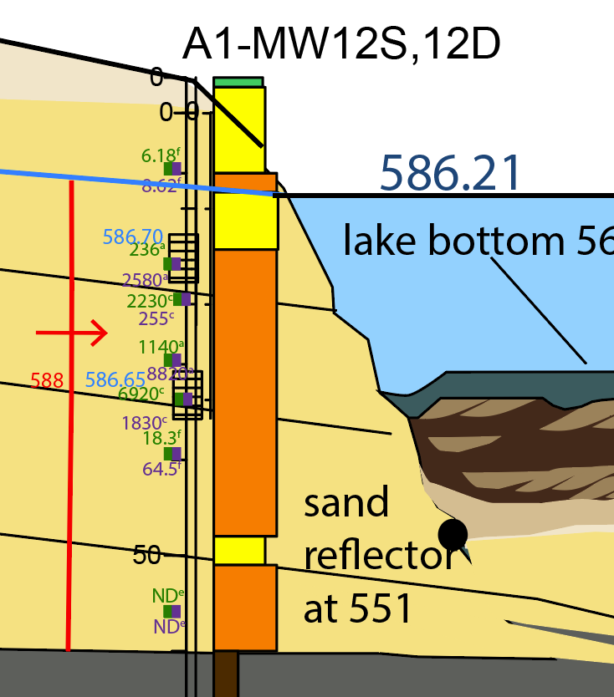
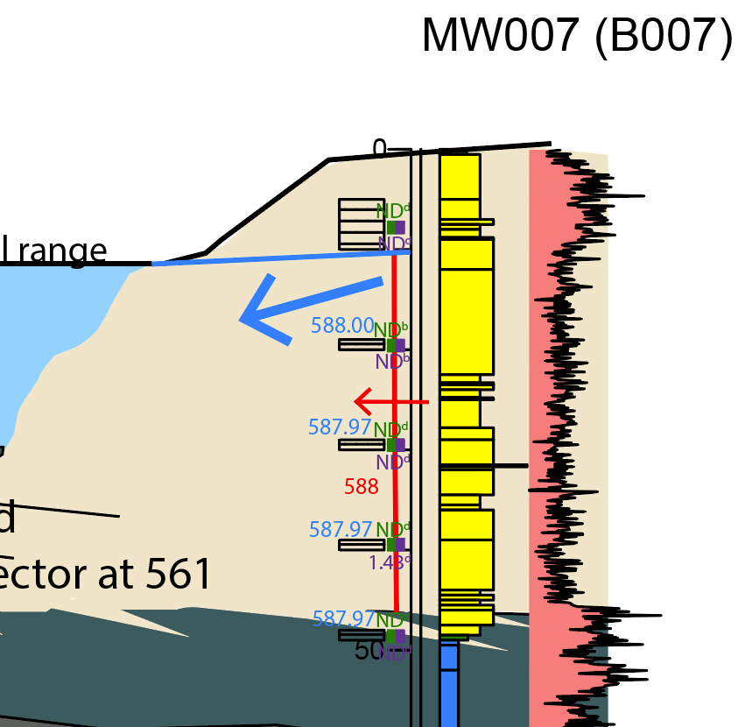
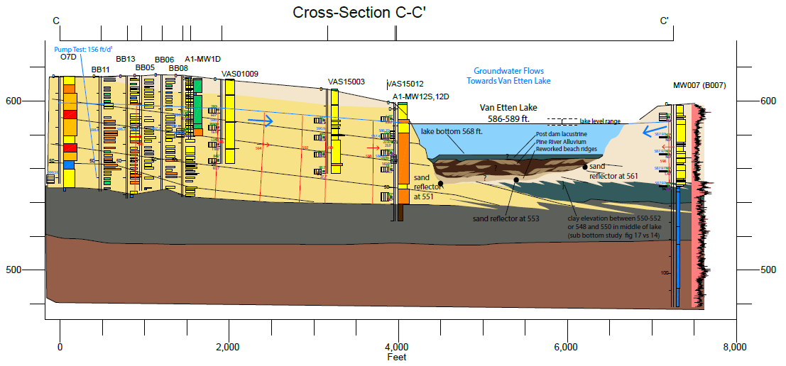
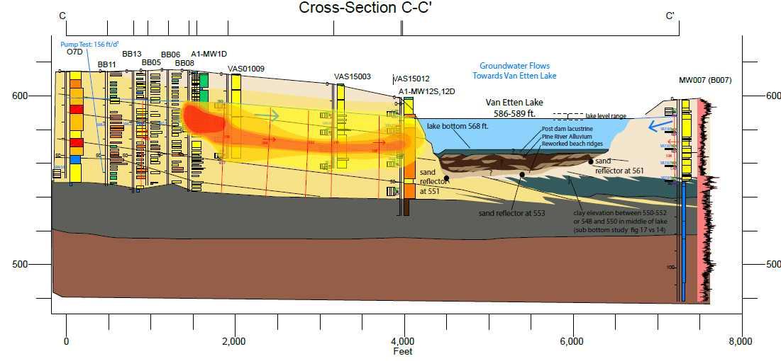
Van Etten Lake: A Groundwater Discharge
Lake With Seasonally Controlled Outlet
~up to 400 ft
dynamic zone
C’
C
Notes:
While the data don’t indicate underflow of ground water to huron, or past the divide, because of seasonal control on dam outlet there is a dynamic zone seasonal gw infiltration or exchange in a ~200 ft zone Heads in column at right are all higher

Slide 16
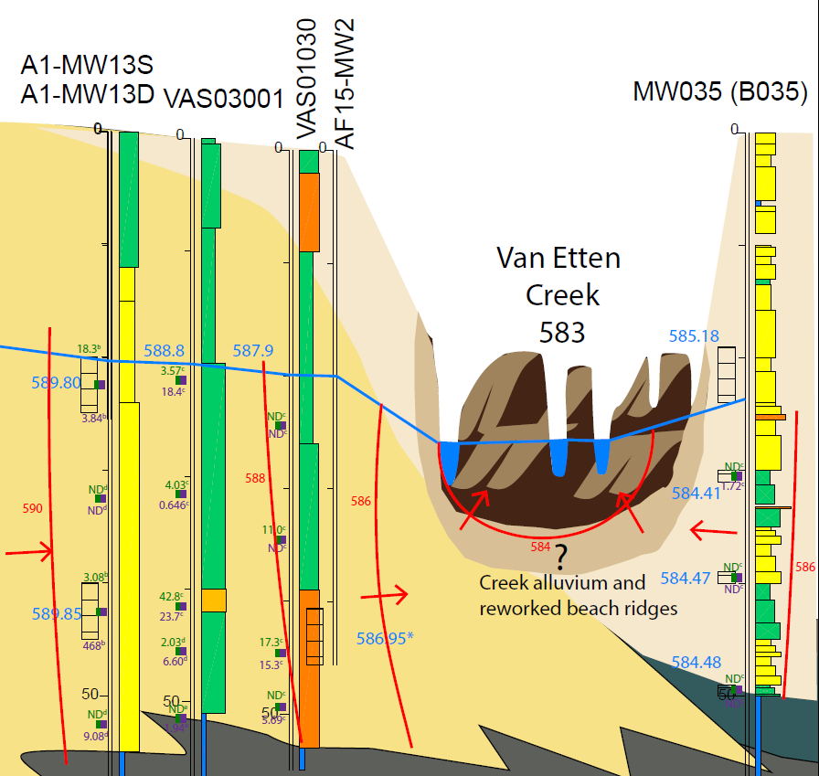
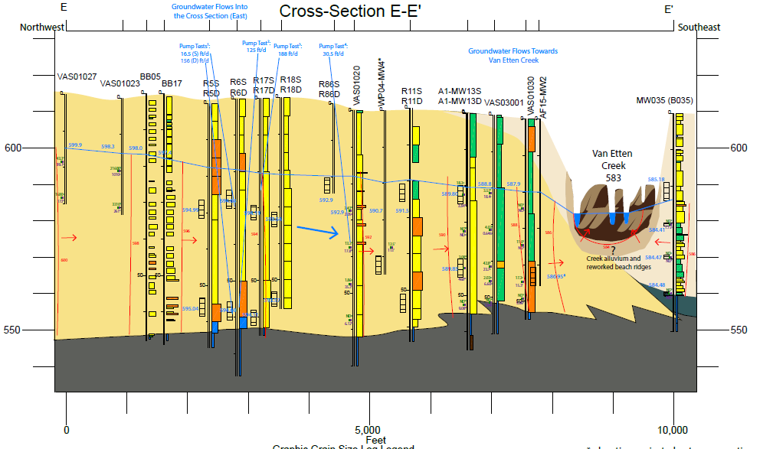
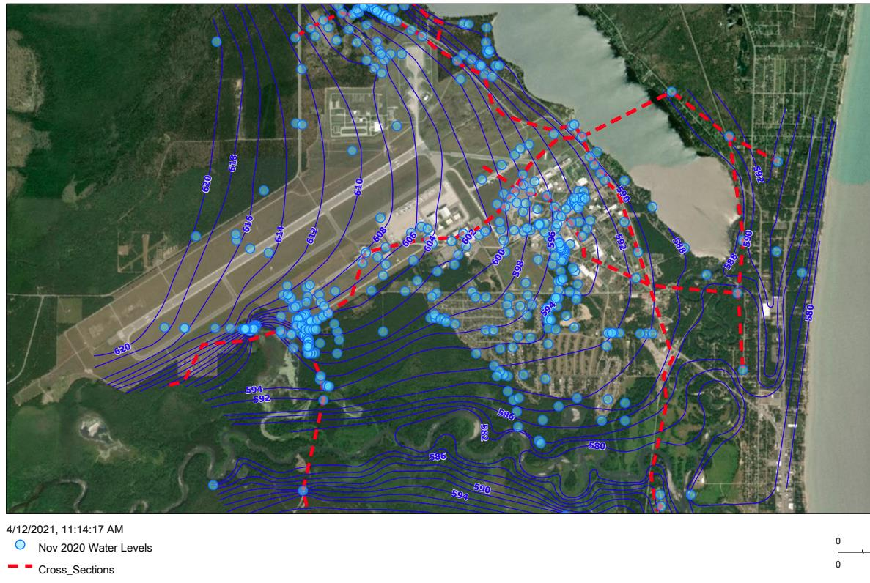
Van Etten Creek and Groundwater Flow
GW Flow into Creek and Out of Page (south), parallel to Creek
Notes:
Talk about the geology and plumbing. East side is a bit analogous to C and A, in that it goes off the margin of the delta
Think 3 dimensionally, flow into page on left, Use PDF
Groundwater discharges into creek, as evidenced by GW gradients and PFAS concs, which are as high as 15 ppt west of creek, ND east of the creek.
Use historic waterlevels and revised section to illustrate Upward gradient at eastern side of creek

Slide 17
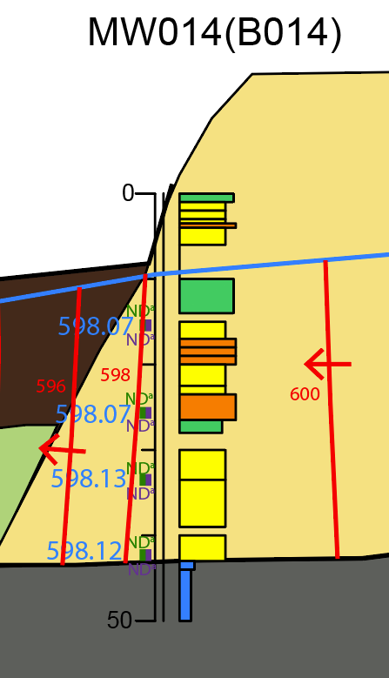
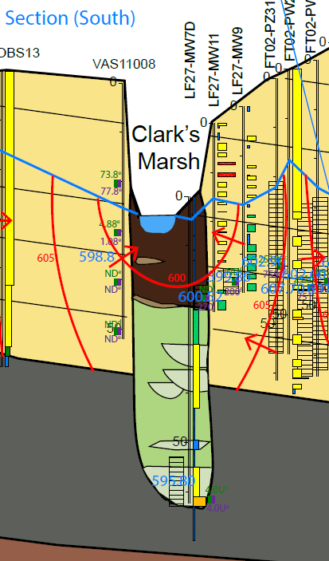
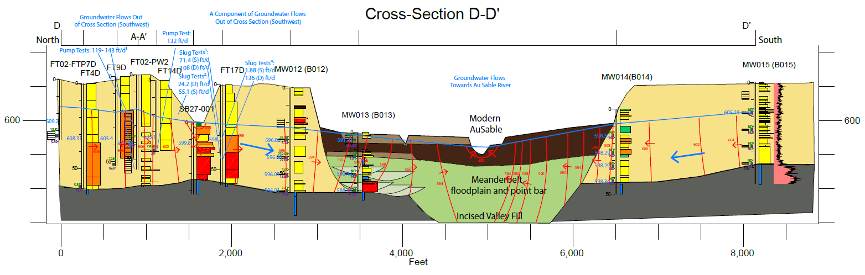
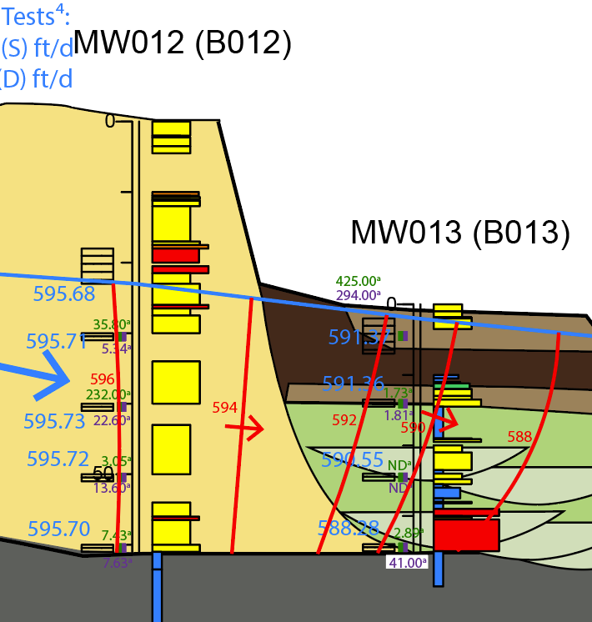
Clark’s Marsh and Au Sable: Cross Section’s A and D
A’
D
Excerpt From A-A’
A
D’
17
Notes:
PDF to be used for details
Take time here to point out basic aquifer/aquitard elements and then major features:
Robust basal aquitard
Deeply incised valley under modern Au Sable that interrupts the more homogenous delta sands and acts as hydraulic impedance at depth
Discharge of ground water to Au Sable river, not underflow occurring. Next slide will show this better.

Slide 18
CSM Data & Concepts Presented
Geology
  “Plumbing of the subsurface” and potential pathways for flow
Hydrogeology
  Observed groundwater elevations and directions of flow
Analytical
  Relationships between observed concentrations and the hydrogeology
Current Synthesis
  Groundwater discharge to surface water bodies on immediate eastern and southern margins likely
  Groundwater underflow off-base not currently indicated by data

Slide 20
Groundwater on Eastern Boundary of Former WAFB
Here the CSM addresses concepts related to:
  Potential underflow of Van Etten Lake and Creek
  Groundwater-surface water dynamics on lake margin
We examine
  Geologic plumbing
  Groundwater flow
  Analytical data
Notes:
Discussion of VanEtten Lake And Creek. Emphasis on three general topic that may serve as lines of evidence that underflow is not occurring:
Geological “plumbing” discussed using sections and explaining rationale behind Interpretation
Hydraulic data and observed head data
Analytical trends
We’ll discuss these three concepts to address van etten creek and ausable river as well

Slide 21
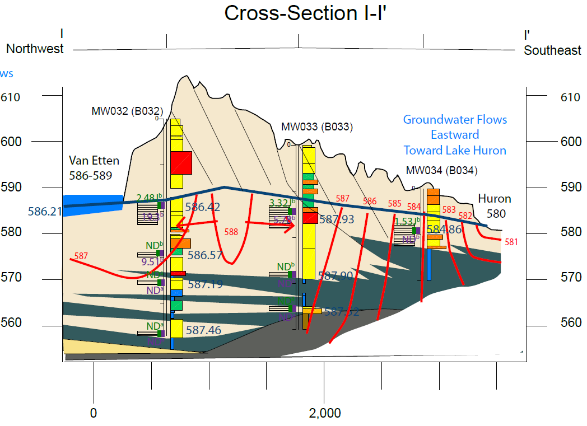

Slide 22
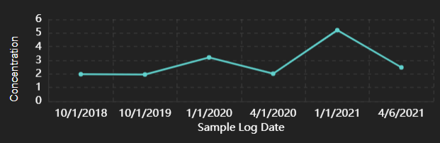
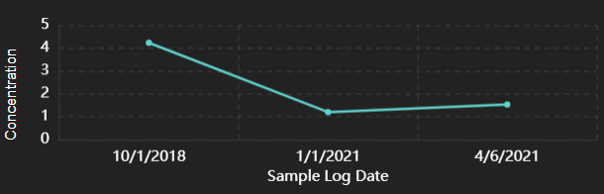
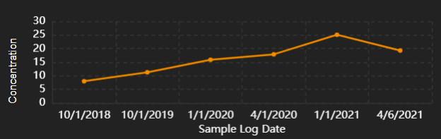
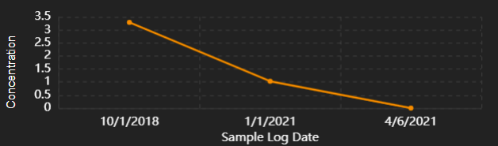
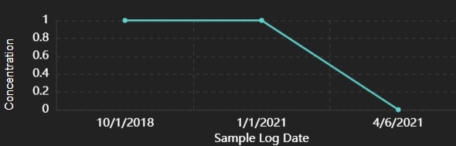
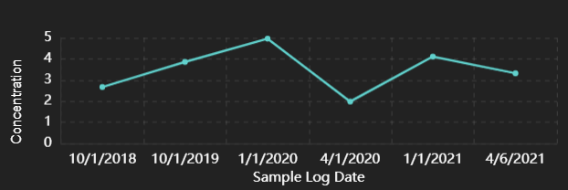
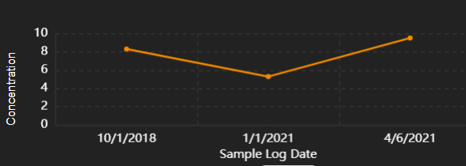
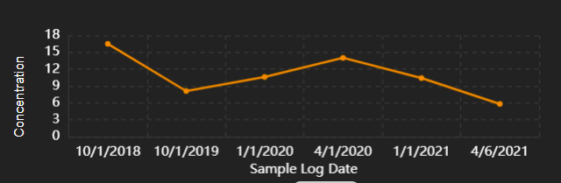
PFOS
PFOS:16ppt
PFOS
PFOA:8 ppt
PFOA
PFOA
PFOS
PFOS
PFOA
PFOA

Slide 23
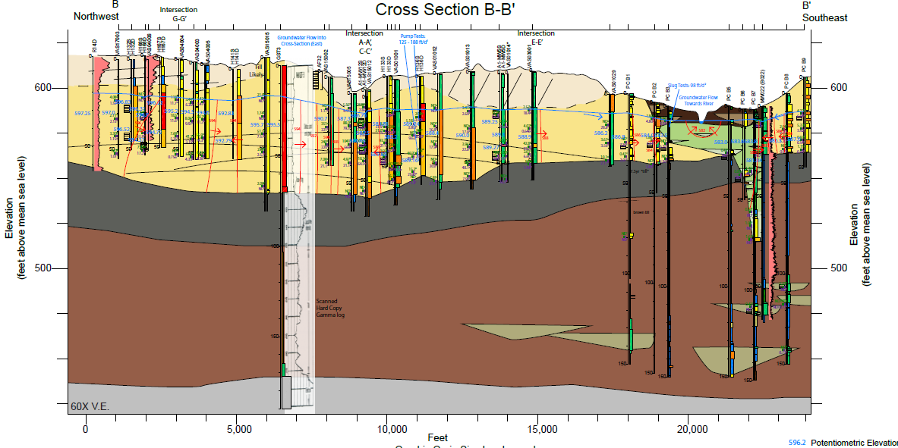
Cross Section B-B’
B
B’
Notes:
PDF to be used for details
Take time here to point out basic aquifer/aquitard elements and then major features:
Robust basal aquitard
Deeply incised valley under modern Au Sable that interrupts the more homogenous delta sands and acts as hydraulic impedance at depth
Discharge of ground water to Au Sable river, not underflow occurring. Next slide will show this better.

Slide 24
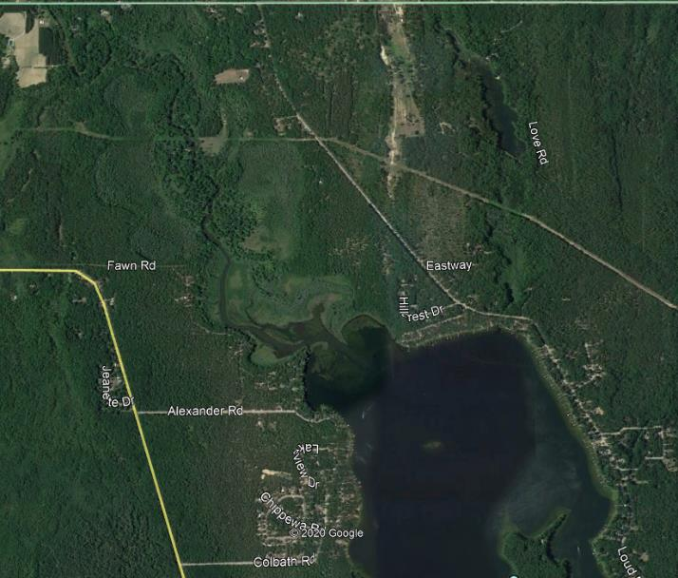
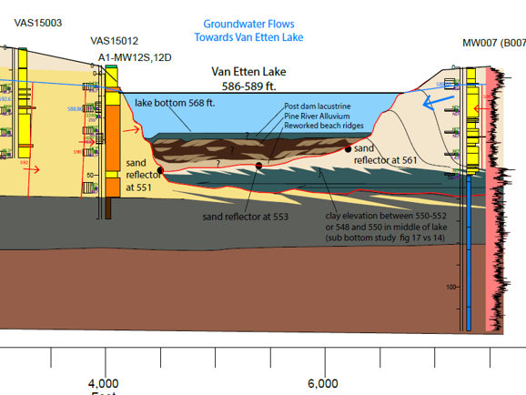
Stratigraphy Beneath Van Etten Lake: C-C’
Heterogeneity (sand, silt, organics, minor clay) predicted by modern analogue
24

Slide 25

Hydraulic and Analytical Data
Hydraulic data indicate convergence at Van Etten Lake
Analytical data do not indicate underflow
Notes:
Move to A-A PDF and hit plumbing, Hydro, and PFAS, see also Potentiometric map on dsmt
Hydraulic data indicate converging flow on both sides toward Van Etten Lake Hydraulic Gradient in the nested Wells is a key data set.
Analytical data also show ND’s and low concentrations on eastern side

Slide 26


Groundwater Dynamics at Van Etten Lake
EGLE 2020
  East side of lake: GW heads are always higher than lake in 6 of 7 monitoring wells. Regional heads show GW flow toward lake
  Only in DEQ-LD-MW003, on SE end of VEL, is head lower than lake, during warm weather months
EGLE, 2020
Notes:
A key study in identifying the dynamic zone - Explain what a pressure transducer does
Van Etten Lake level in red, note seasonal lowering, lake is high in the April-October timeframe
Key point is that on the east side of the lake, is that wells MW005, 007, 008 all are higher throughout the year- indicating discharge to lake . MW03 in purple shows that it is lower than lake through April-October time frame

Slide 27

Groundwater Dynamics at Van Etten Lake
27
Notes:
In a similar time window, MW032 transitions from clearly higher, to potentially lower than the lake. A bit speculative, but indicative that it is within or on the margin of the dynamic zone, MW-33 which is over 1000 ft from the lake is again routinely higher. Indicating the limits to this zone of dynamics

Slide 28

Seasonal Flow from Lake
Occurs only in a limited area near shore on S-SE side of lake (see next slide)
Occurs only during Warm Months
Predominant GW flow is toward lake elsewhere
July 2019
Notes:
There is a very limited area near shore on the SE side of VEL where there is back and forth exchange of water with the lake and groundwater.
This occurs during the periods of high stand of the lake, when the lake outlet is raised from an elevation of 586 ft to 589 ft, from May to October

Slide 29

Seasonal Flow from Lake Inland
Occurs only in South-Southeast Portion of VEL
Small gradient inland from April through September
Groundwater velocity: V=KI/n =(30 ft/d)(1.0 ft/100 ft)/(0.3) = 1.0 ft/d
Estimated distance of seasonal inflow: d=vt=(1.0 ft/d)(180 d) =180 ft
Flow reverses to flow toward lake during October through March, when lake level is lowered
July 2019
Notes:
The raising of the lake outlet results in some seasonal flow from the lake inland or a period of up to 6 months per year.
This flow only occurs in a narrow band along the S-SE edge of the lake. Heads outside this narrow band are consistently higher than the lake, indicating groundwater flow toward the lake.
Only in a narrow band on the S-SE side is there any evidence of temporary groundwater heads that are lower than the lake.
Groundwater velocity calcs show that groundwater velocity is about 1 ft/d near the lake during these periods of high lake stand.
During the 6-month period of high lake level, groundwater would be expected to migrate approx. 180 ft inland, in this narrow band.
The flow would then reverse, and groundwater would flow strongly toward the lake from October through March.

Slide 30

Van Etten Creek and Groundwater Flow
GW Flow into Creek and Out of Page (south), parallel to Creek
Notes:
Talk about the geology and plumbing. East side is a bit analogous to C and A, in that it goes off the margin of the delta
Think 3 dimensionally, flow into page on left, Use PDF
Groundwater discharges into creek, as evidenced by GW gradients and PFAS concs, which are as high as 15 ppt west of creek, ND east of the creek.
Use historic waterlevels and revised section to illustrate Upward gradient at eastern side of creek

Slide 31

Van Etten Creek and New Vertical Aquifer Sampling Results
H
K
K’
H
M
M’

Slide 32

Van Etten Creek and New Vertical Aquifer Sampling Results
H
K
K’
Results indicate groundwater surface water exchange
H
M
M’

Slide 33


Van Etten Creek and New Vertical Aquifer Sampling Results
H
K
K’
M
H
M’

Slide 34

Van Etten Creek and New Vertical Aquifer Sampling Results
H
K
K’
M
H
M’

Slide 35

Van Etten Creek and New Vertical Aquifer Sampling Results
H
K
K’
M
H
M’

Slide 36

Van Etten Creek and New Vertical Aquifer Sampling Results
H
K
K’
M
H
M’

Slide 37

Clark’s Marsh

Slide 38


Clark’s Marsh
Notes:
PDF with toggle layers to be used for clarity and details
Geology
Heads, discharge to clarks marsh, isolation of valley fill,

Slide 39
Hydro Basics

Slide 40

Analogous Groundwater Surface Water Scenarios
Scenario similar to
  West side of Van Etten Creek
  North end of Clark’s Marsh
  Margins of Au Sable Valley
Scenario similar to
  Au Sable River
  Van Etten Creek
T.C. Winter, 1999

Slide 41


Groundwater-Lake Systems
Discharge Lake: No outflow from lake to groundwater on either side or bottom. Lack of strong vertical gradients. Similar to Van Etten Lake
Recharge-Discharge Lake: Outflow through bottom occurs when there are steep groundwater vertical gradients, plus a permeable geologic unit at depth. Dissimilar to Van Etten Lake
T.C. Winter, 1976
41

Slide 42

Groundwater Gradients in Gaining Streams and Losing Streams
Groundwater gradients are toward stream in gaining streams, and away from stream in losing streams.
Au Sable River and Van Etten Creek show gradients toward the stream, characteristic of a gaining stream
T.C. Winter, 1999

Slide 43
Geology back up slides

Slide 44

Geologic Evolution of Site Stratigraphy
Notes:
Step through evolution of landscape/stratigraphy.
A key take away is that facies and hydraulic relationships & Parameters along the dashed line areas are key to understanding the potential for offsite migration, particularly with respect to issues of underflow.

Slide 45



Slide 46


Sub-Bottom Van Etten EGLE Study

Slide 47


Au Sable River Valley and Paleo Valley

Slide 48

Au Sable River Valley and Paleo Valley
Notes:
Key take home here is that seeps to Au Sable Valley Wetlands are a potential issue, as is groundwater connectivity to tributary creeks
While sparse data exists within the central valley, data and geological context presented indicates deeply incised valley characterized by finer grained, heterogenous lagoonal, floodplain, and point bar deposits. This means that there is not a clear permeable pathway across the valley.
Gradients in wells are consistent and generally analytical is consistent as well.

Slide 49


Paleo Valley Orientation and Detected Edge

Slide 50


25ft/11638 ft
11 ft per mile slope
50

